Slide 1
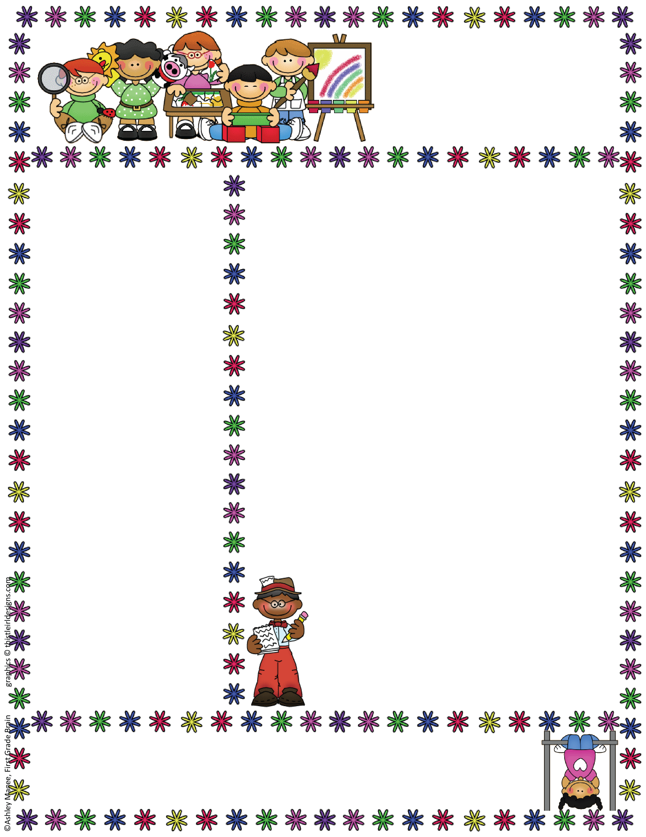
Bethany Lutheran Preschool
4 year old class
Mrs. Korta & Mrs. Currlin
Mrs. Truss
March 2025
Dates to Remember
Dr. Suess week 3/3-3/7
Scholastic Book orders Due March 24th
Conferences – March 24th and March 25th
Classroom News
I cant believe March is here! This month we will start to write our last names in our name books if they are ready. Our AM class can now bring full lunches to school to start preparing for Kindergarten. We will celebrate Dr. Suess and our love for reading with a fun spirit week. Please see attached flyer. We only have a few letters left, so we will continue to review both letters and numbers. This month we will talk about rainbows and all the signs of spring! During letter Aa week will we do an “All about Me” project and the students will get to talk all about themselves. This month we will also hold conferences for your child. Sign ups will go out through a sign up genius email.
Just a reminder, that if something changes at home, such as a parent going back to work or going away for business, please let us know so we can support your child. Little changes in schedules can have big impacts on children and we want to support them the best way we can.
What we are learning
This month we will continue to write in our name books and explore new letters.
3/3- Letter Kk
3/10- Letter Aa
3/17- Letter Nn
3/24- Letter Mm
Each week on your share day please bring in an object to talk about that begins with that letter.
Mrs. Rachel Korta Email address: rlkorta@yahoo.com
Bethany Lutheran Preschool Phone Number: school: 860 632-0597
4 year old teacher cell: 860- 508-6530

